Slide 1
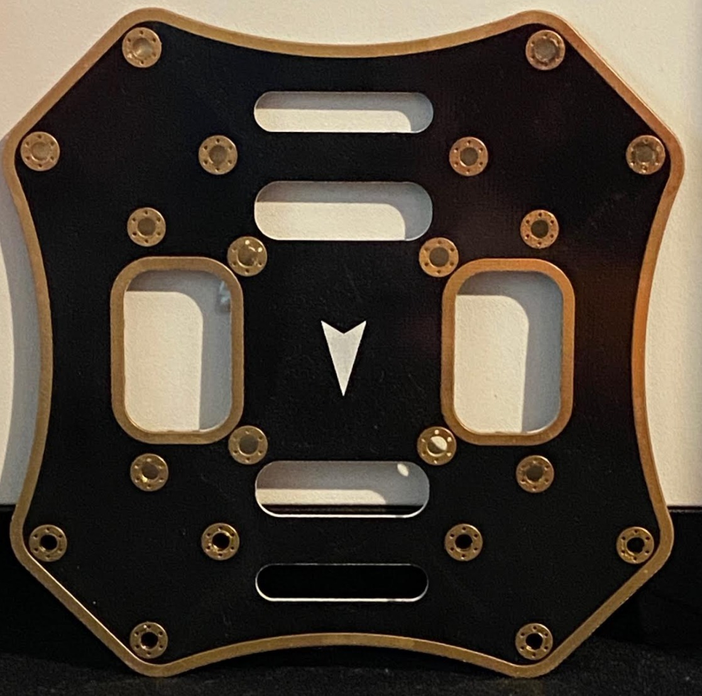
2.50 in
0.90 in
1.094 in
2.50 in
3.75 in
2.50 in
3.75 in
2.50 in

Slide 2
4.25 in
4.25 in

Slide 3


